Slide 1
Student services tracking system
JAVA
UI
</>
Dart
UX
2023-2024

Slide 2
Student services tracking system
Team Names
ID
1
Kerolos rafat monier 2001284
2
Hedra talat Hosny 2000429
3
Marina medhat weliam 2000528
4
Yassa kamal anwar 2001165
5
Marina toman hosney 2000711
6
Kerolos yassa roshdey 2000720
7
Abanob mamdoh ramzy 2000712

Slide 3
INTRODUCTION
Is a software application or information system designed to manage and streamline various services and processes related to students within an educational institution, and helps educational institutions keep track of, the system typically focuses on enhancing the overall student experience, improving administrative efficiency, and ensuring that students have access to the support and resources they need.
</>
HTML
C++

Slide 4

Related ideas
There is no university without a student service tracking system, like our university: EElU, but in this project there are some different features that make it easier for the student to interact with the college
online, and in our project, we will display all the features through this Application.
As it will contain the main components for the student, after he login into the application through his ID and password

Slide 5
Problem and solution
Problem
Lack of accurate knowledge of scholarships, competitions, and activities due to the large number of schedules within the college
It is difficult to obtain certificates from college affairs, and this causes significant time and effort disruption
The difficulty of going to college and the crowding of students at affairs when students register their subjects
Failure to solve students’ problems, organize their complaints, and respond to their questions in a quick time
You can obtain all types of certificates easily through this application
Receive all students’ questions and complaints and work to solve them as quickly as possible
Students can easily register subjects through the application
Ease of knowing about university scholarships and participating in all activities
Solution

Slide 6




Methodology
Front-end
In Front-end we will use flutter framework
Back-end
In Back-end we will use Node.js
Database
In Database we will use Firebase
UI & UX
In UI & UX we will use Figma program

Slide 7
features of the application
Complaints: We will find a complaints section, which makes it easy for him to ask any question and learn anything about the university, and when he wants to complain about anything.
01.
02.
Registration: This makes it easy. The student should be able to register his subjects without needing to go to college. This will save time and will also make it easier for the student if his address is far from the university.

Slide 8
features of the application
03.
Certificates: You can obtain certificates of all kinds, such as proof of registration, military certificate, certificate of results for each semester, transcript of grades, and graduation certificate.
04.
Scholarships: This is intended for some outstanding students only, and then the university provides some fully funded scholarships and semi-funded scholarships.

Slide 9
features of the application
05.
Activities: Where activities of all kinds, how to participate in them, and follow up on competitions with other universities.
06.
Notifications: Where a schedule of all appointments appears in the calendar, including lectures and sessions, as well as quizzes and office hours. When the deadline approaches, a message will arrive in the notifications so that the student remembers the deadlines well.

Slide 10
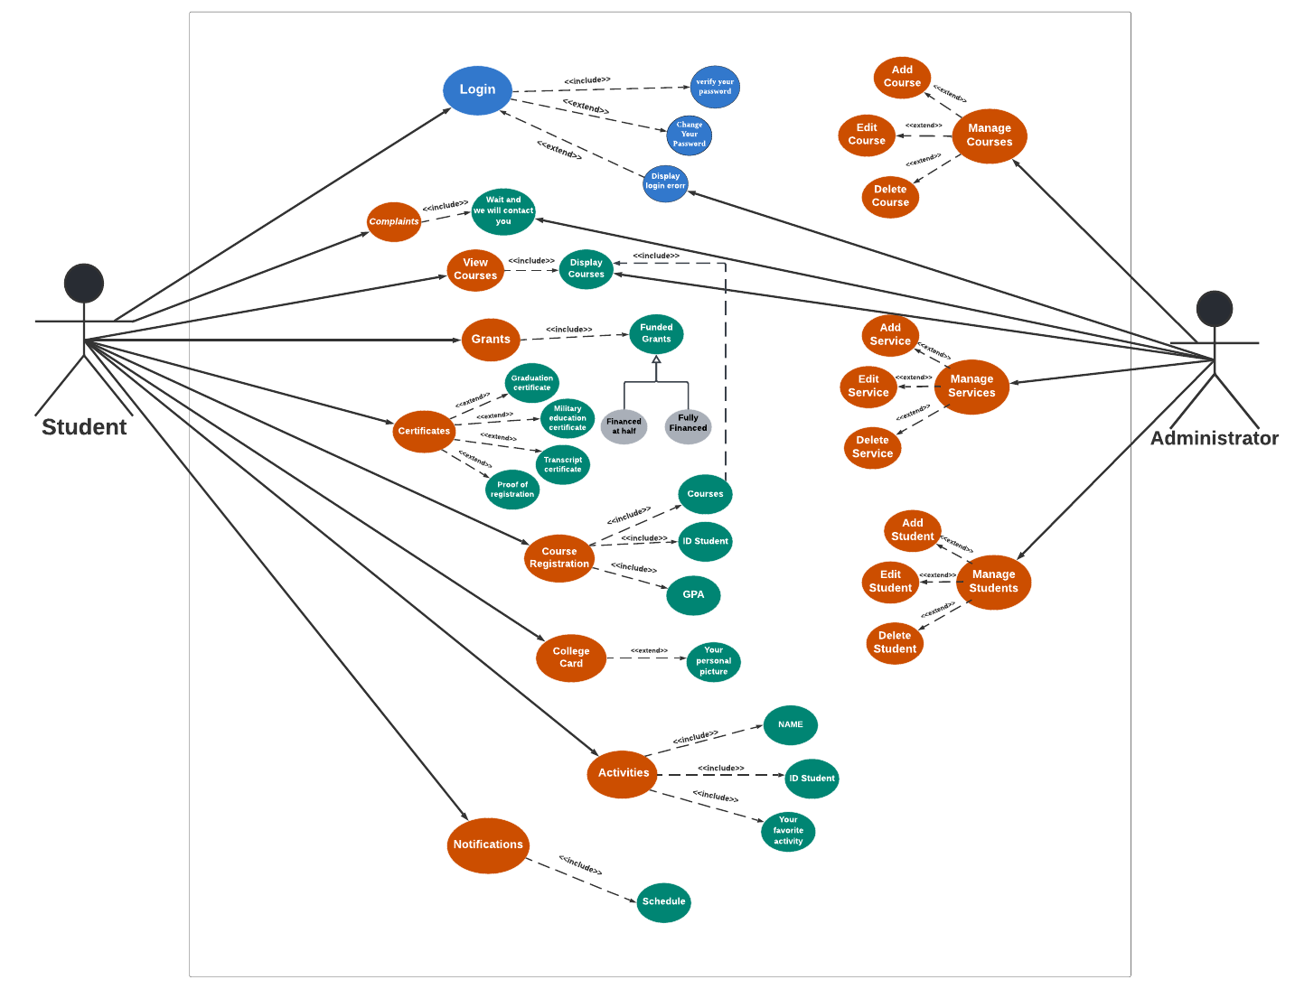
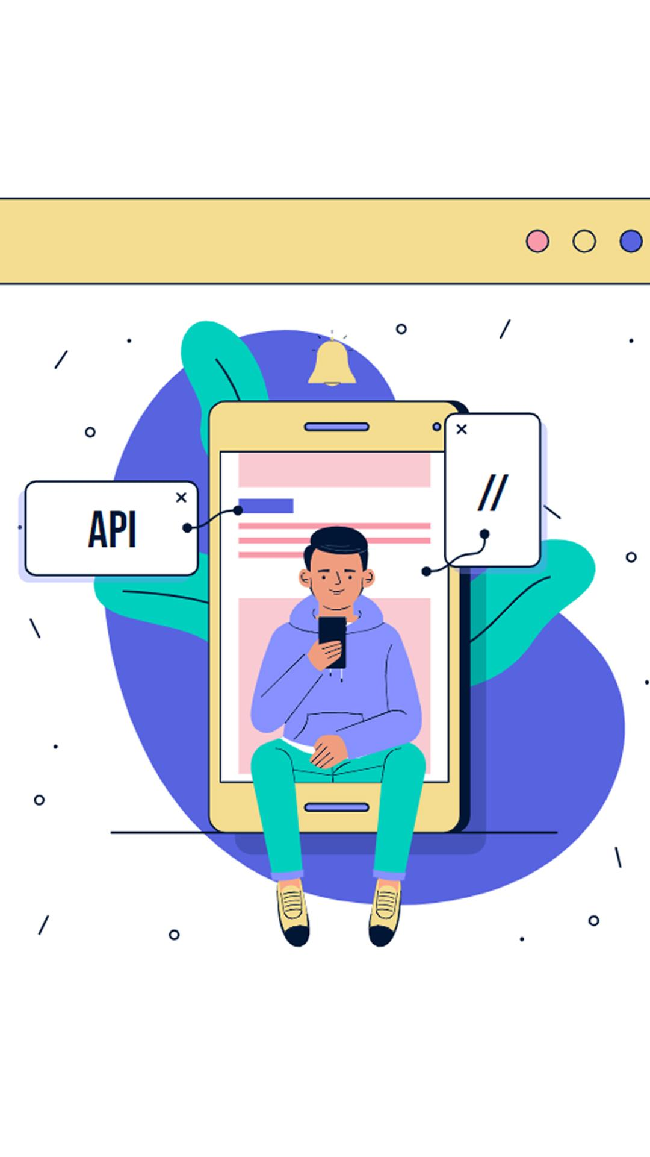
Use case DiAgram

Slide 11
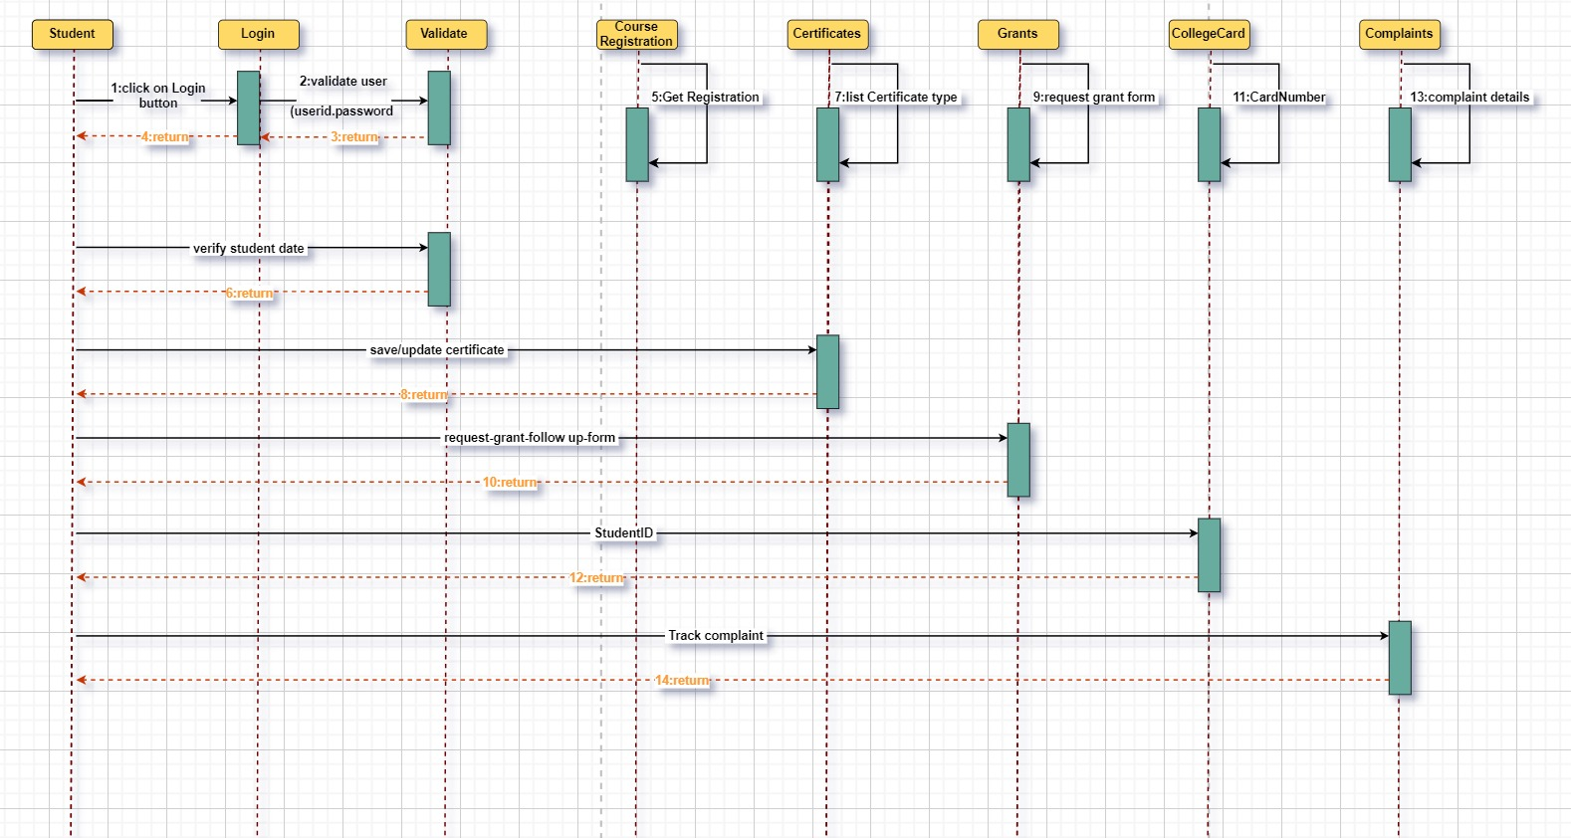
Squance Digram

Slide 12
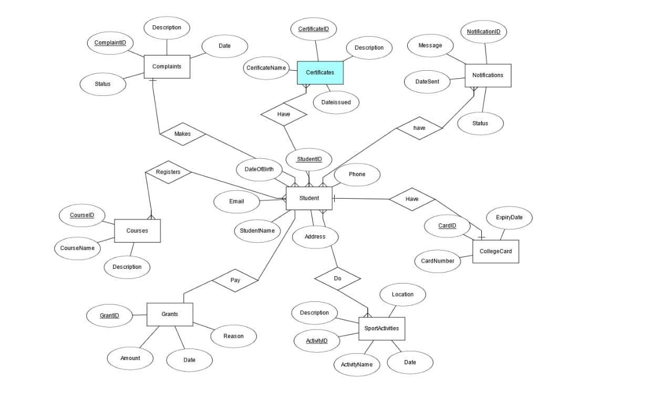
ERD DiAgram

Slide 13
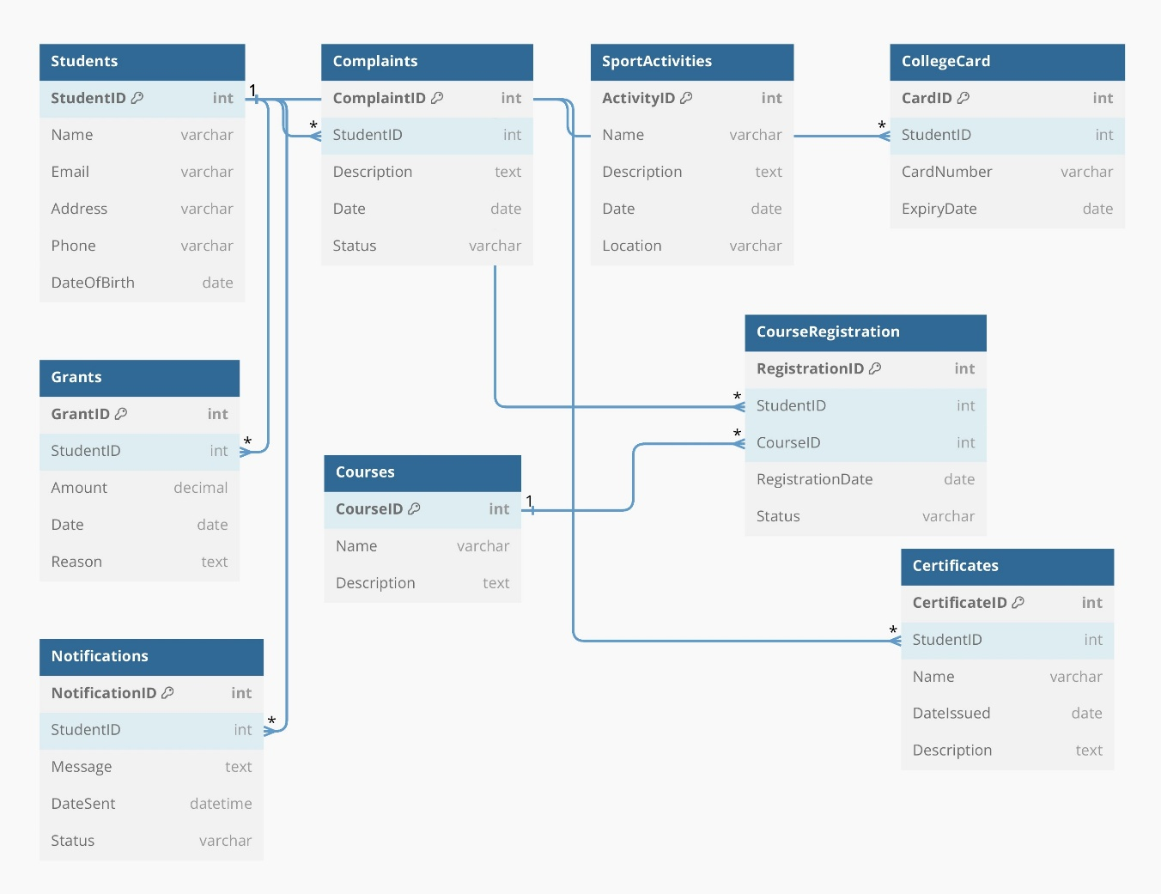
Schema DiAgram

Slide 14
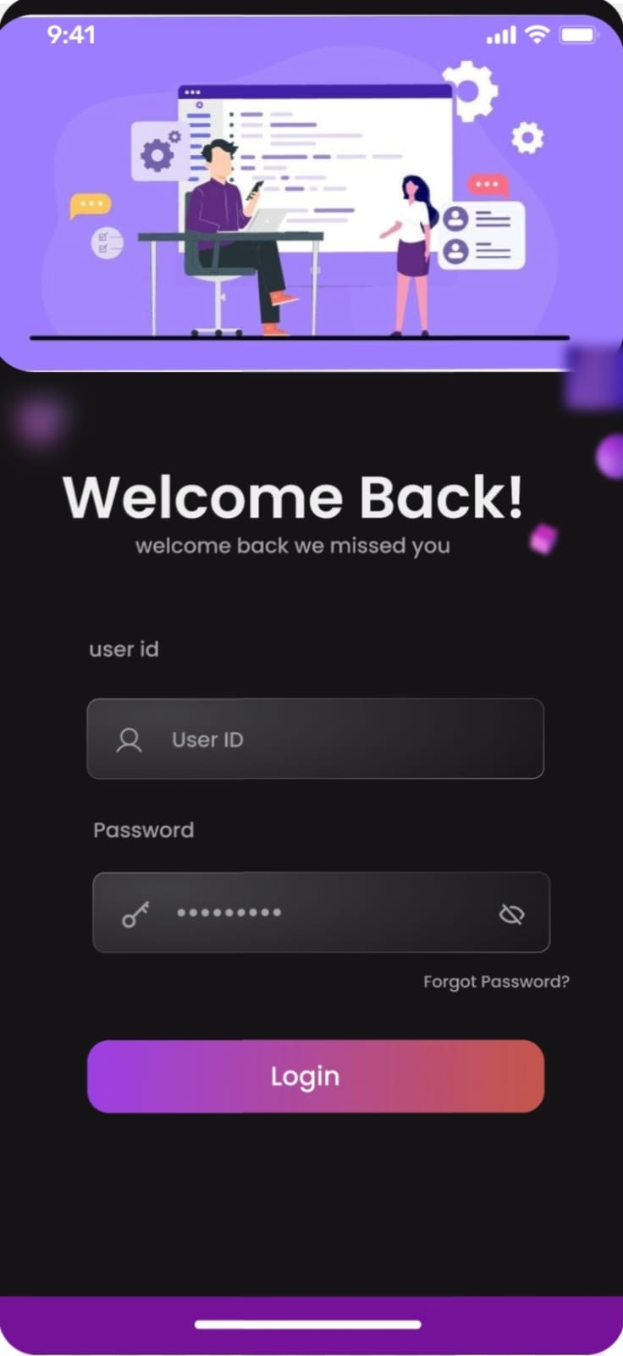
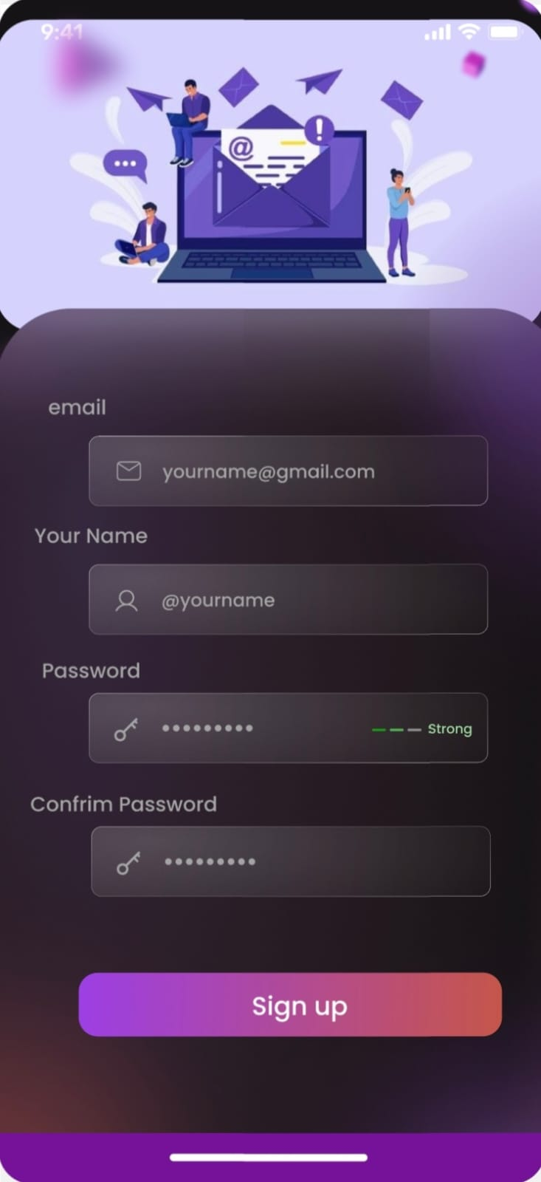
UI & UX for project
LOGIN
FORGET PASSWORD

Slide 15
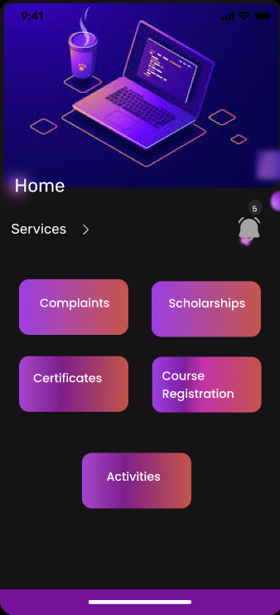
UI & UX for project
Home page

Slide 16
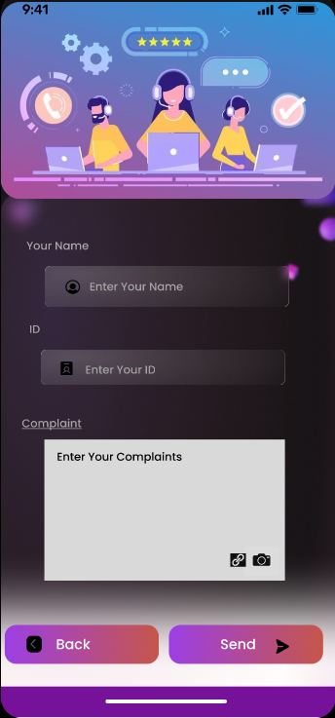
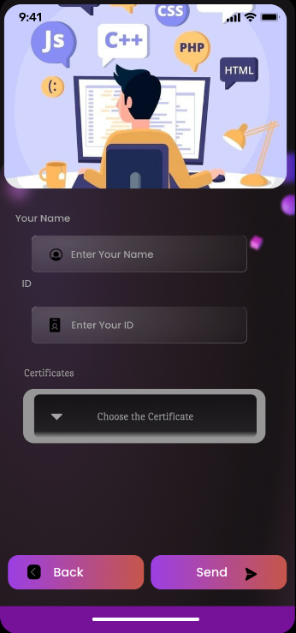
UI & UX for project
complaints
Certificates

Slide 17
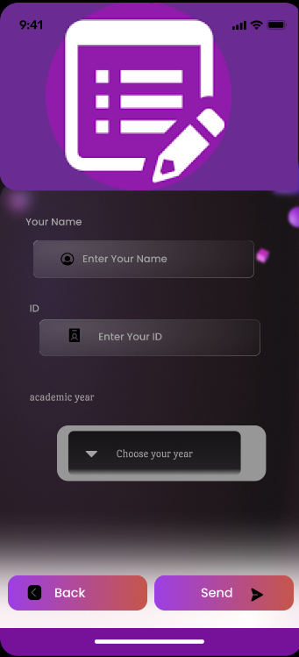
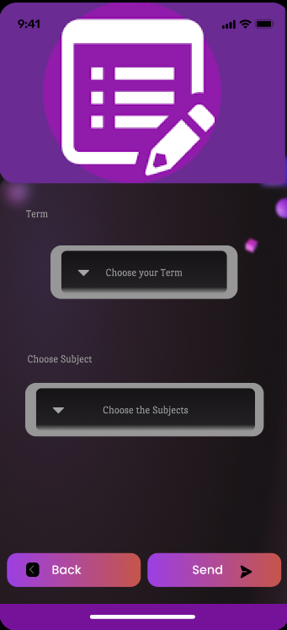
UI & UX for project
Course Registration

Slide 18
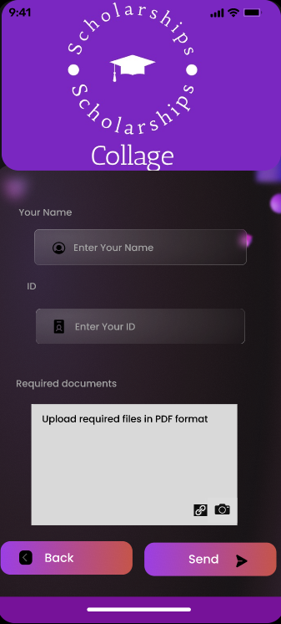
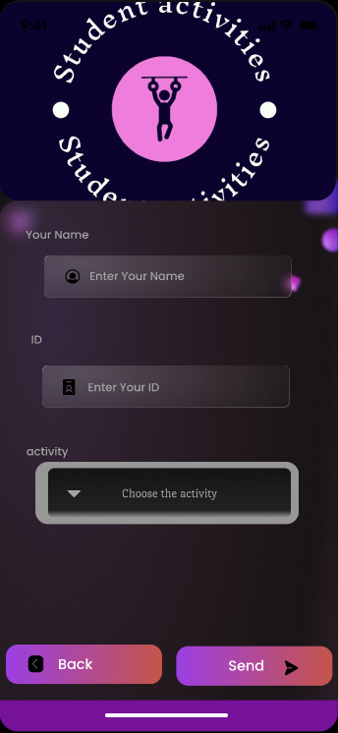
UI & UX for project
Scholarships
Activities

Slide 19
Task table
 | DATE ( from – to ) | TASK
01 | 2-10-2023 / 5-11-2023 | Choosing a team and choosing a project idea
02 | 5-11-2023 / 15-12-2023 | Arranging and planning according to the idea and distributing tasks
03 | 15-12-2023 / 25-1-2024 | The team began working on the presentation and we identified the project's features
04 | 25-1-2024 / 10-2-2024 | The team began implementing plans and coding all agreed upon ideas

Slide 20
Name of the project idea --------------------------------- 1
Team Names and ID --------------------------------- 2
Introduction --------------------------------- 3
Related ideas --------------------------------- 4
Problem and solution --------------------------------- 5
Methodology --------------------------------- 6
Features of the application --------------------------------- 7-9
Use case Diagram --------------------------------- 10
Sequence Diagram --------------------------------- 11
ERD Diagram --------------------------------- 12
Schema Diagram --------------------------------- 13
UI & UX for project --------------------------------- 14-18
Task table --------------------------------- 19

